Slide 1

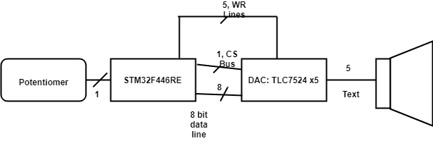
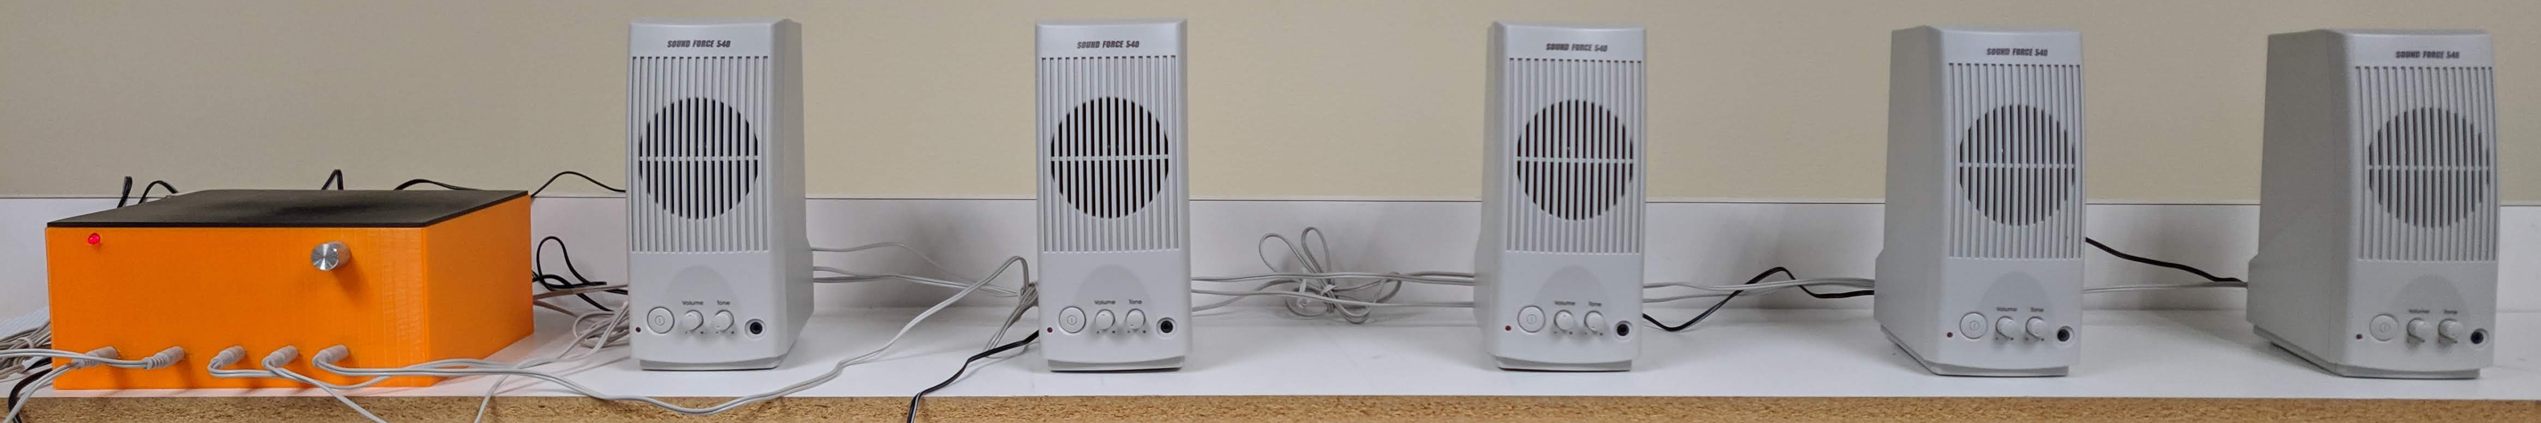
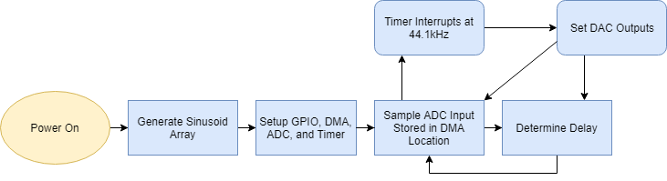
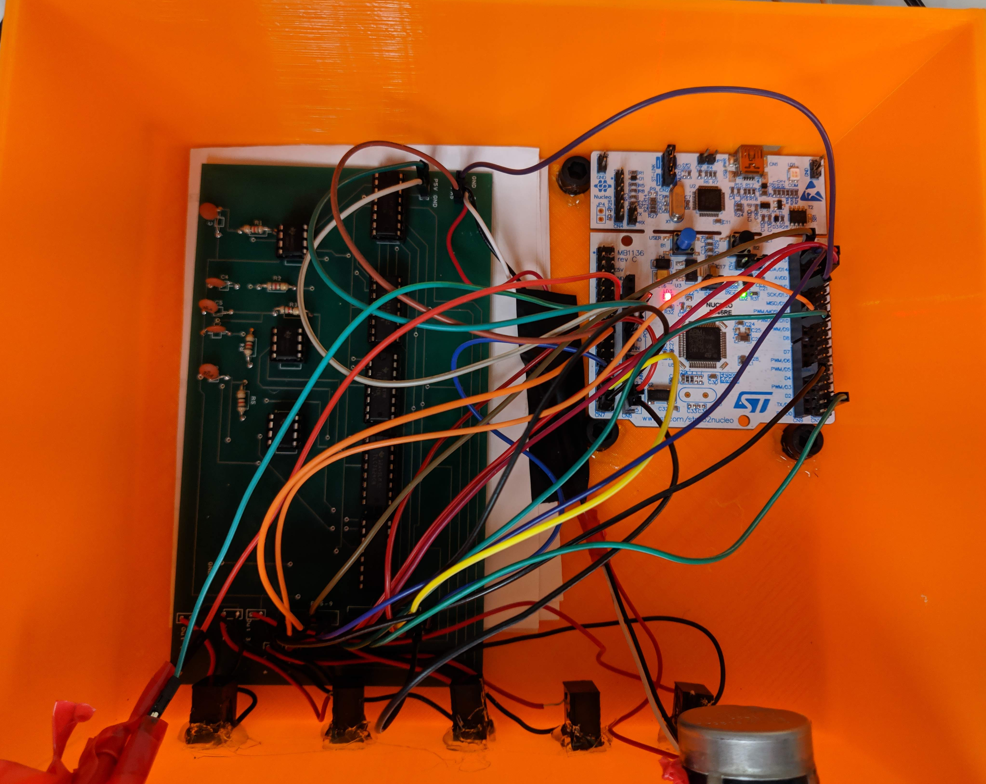
Phased Array in Sound
Austin Brummett, EE
Advisor: Dr. Blandford
Abstract
The phased array in sound generates a tone via the STM32F446RE microcontroller that can be phased adjusted by the user through a potentiometer. This creates a sense of directional sound outputting from a line array of speakers which is useful in demonstrating how a phased array system works. Applications of phased arrays are found in many places, such as broadcasting, radar systems, and ultrasonics.
Hardware Design
Features
Approximately 1 kHz 8-bit sinusoidal output tone sampled at 44.1 kHz via a timer interrupt
Works with any five speakers with internal input amplifiers and a 3.5 mm jack
Adjustable by potentiometer
Five DACs were hooked up to an 8 bit data bus, a chip select bus, and write bus from the STM32F446RE
The DAC’s outputs were sent across a passive RC lowpass filter with a cutoff of approx. 22.1 kHz and then to the speakers via 3.5 mm jack
Software Design
Final Design and Results
te
This project is tested by having a listener walk across the array to detect a change in the direction of the sound
An oscilloscope was used to prove that the sine waves are phase shifted

